Slide 1
Introduction to
VBA Programming

Slide 2
RoadMAP
Lesson Outline
Starting Excel VBA
Write Your First Macro
Visual Basic Datatypes

Slide 3
Lesson Outline
Introduce main programming constructs
Introduce Visual Basic for Applications (VBA) in an Excel Environment
Prepare for upcoming practical sessions
Note: Computer Programming is a highly marketable skill. Make the most of this opportunity

Slide 4
Lesson Outline
Office is an integrated package:
word processing, database, spreadsheet, …
Concentrate on Excel
Skills:
applicable to other Office elements
will still be applicable when suite updated
transferable to other programming languages

Slide 5
Lesson Outline
Each line of code executed in the exact order presented
Not like spreadsheets where formulae can refer to cells wherever they are
Need to think logically

Slide 6
RoadMAP
Lesson Outline
Starting Excel VBA
Writing your first Macro
Visual Basic Datatypes

Slide 7
Starting Excel VBA
Visit the highlighted short link, ensure that macro should be enabled on your computer
https://cutt.ly/YknO7pV
https://support.microsoft.com/en-us/office/quick-start-create-a-macro-741130ca-080d-49f5-9471-1e5fb3d581a8#:~:text=If%20you%20have%20tasks%20in,many%20times%20as%20you%20want.&text=You%20can%20create%20and%20then,to%20the%20cells%20you%20select.

Slide 8
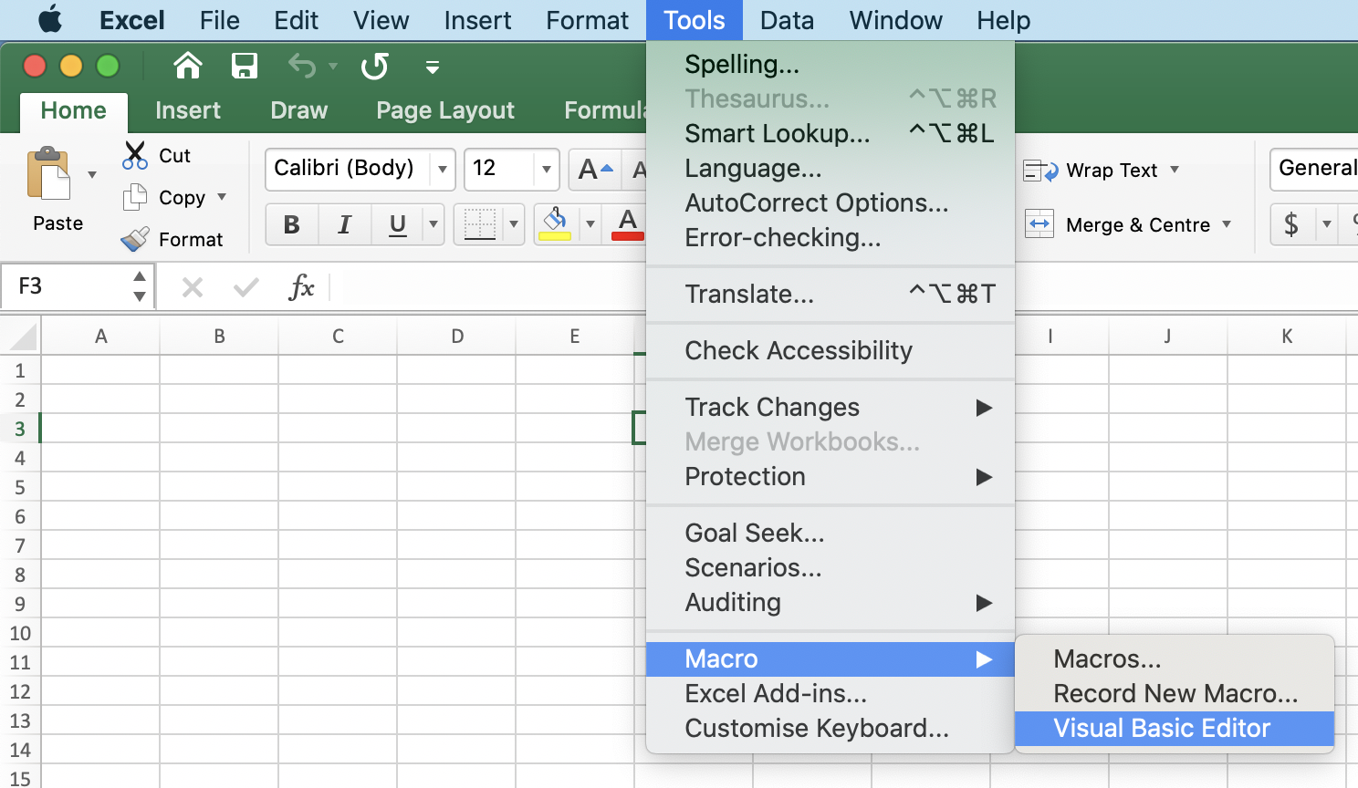
How to open VBA in Excel ? (MAC)
Options are listed below, Excel Macro’s & Visual Basic Editor

Slide 9
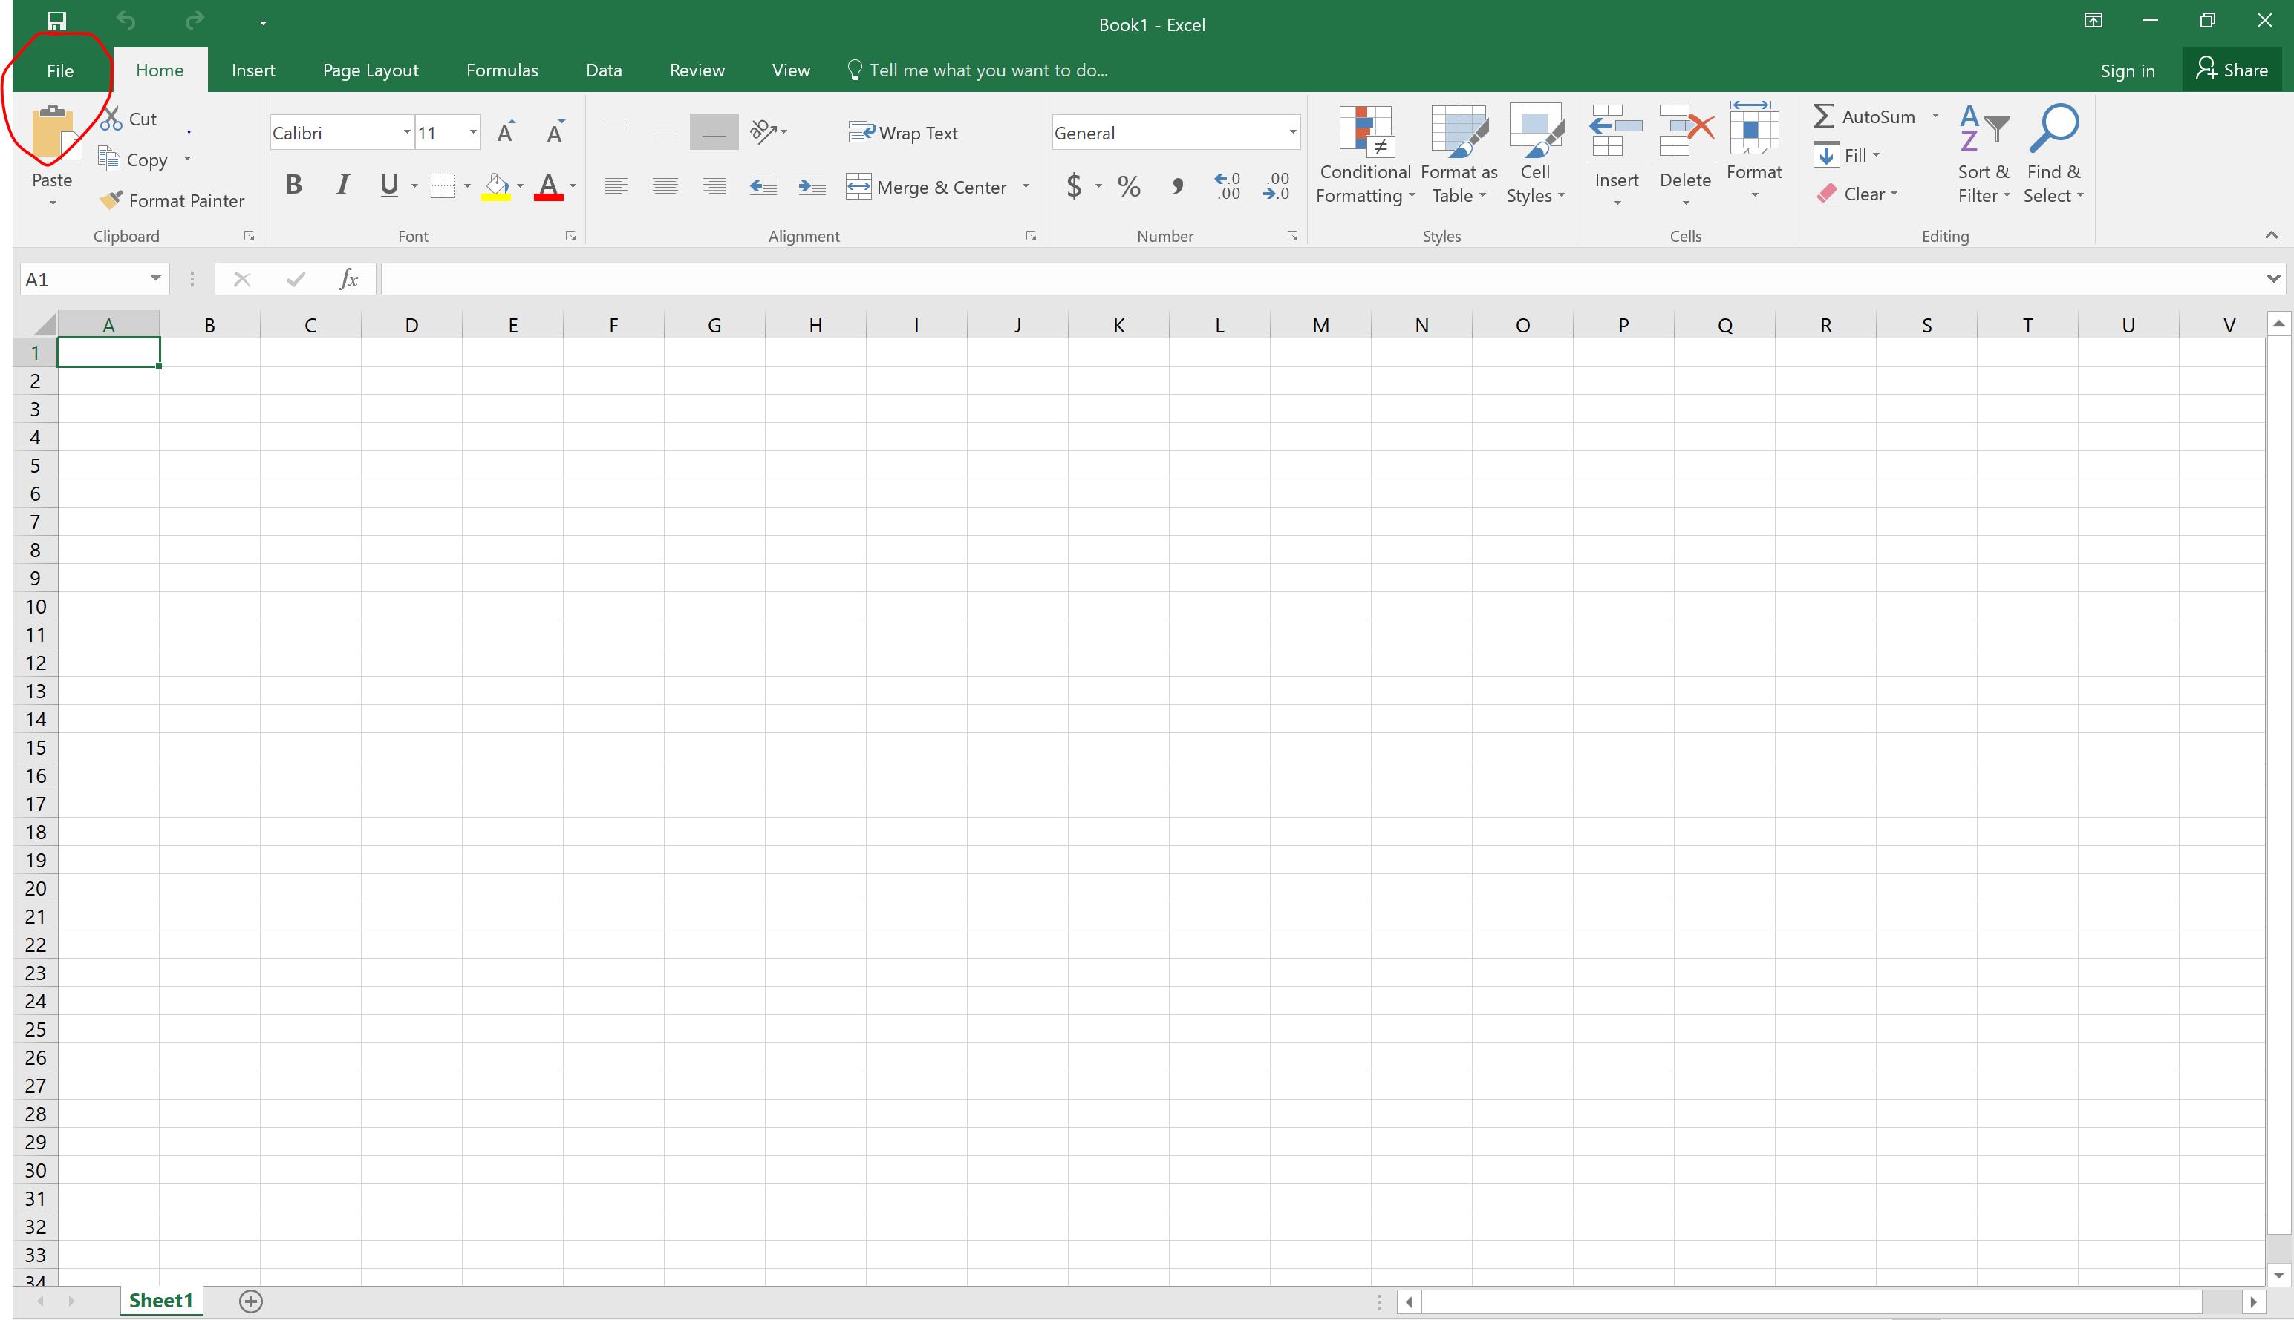
How to open VBA in Excel ? (Windows)
Click on the “File” Tab

Slide 10
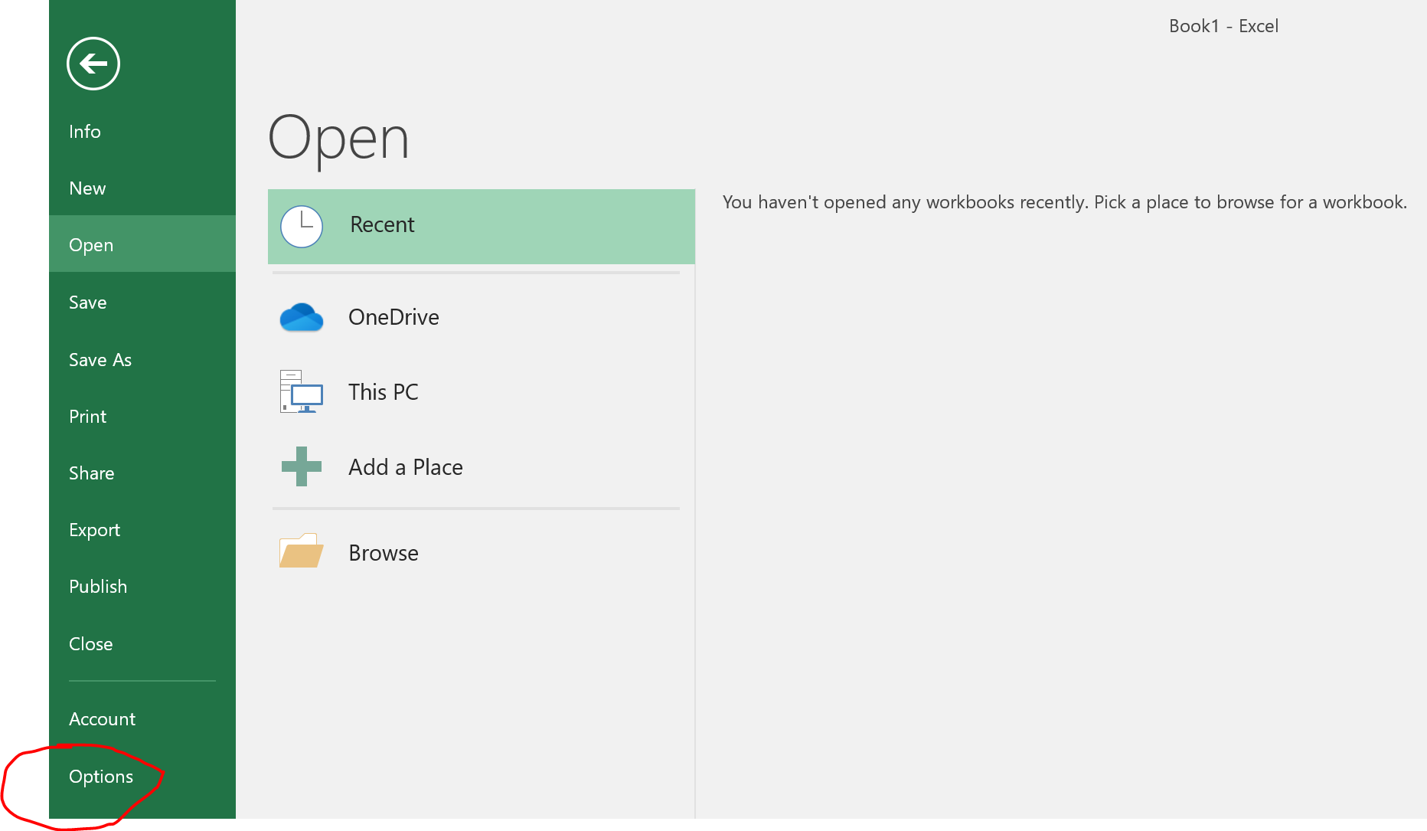
How to open VBA in Excel ? (Windows)
Click on the “options” tab

Slide 11
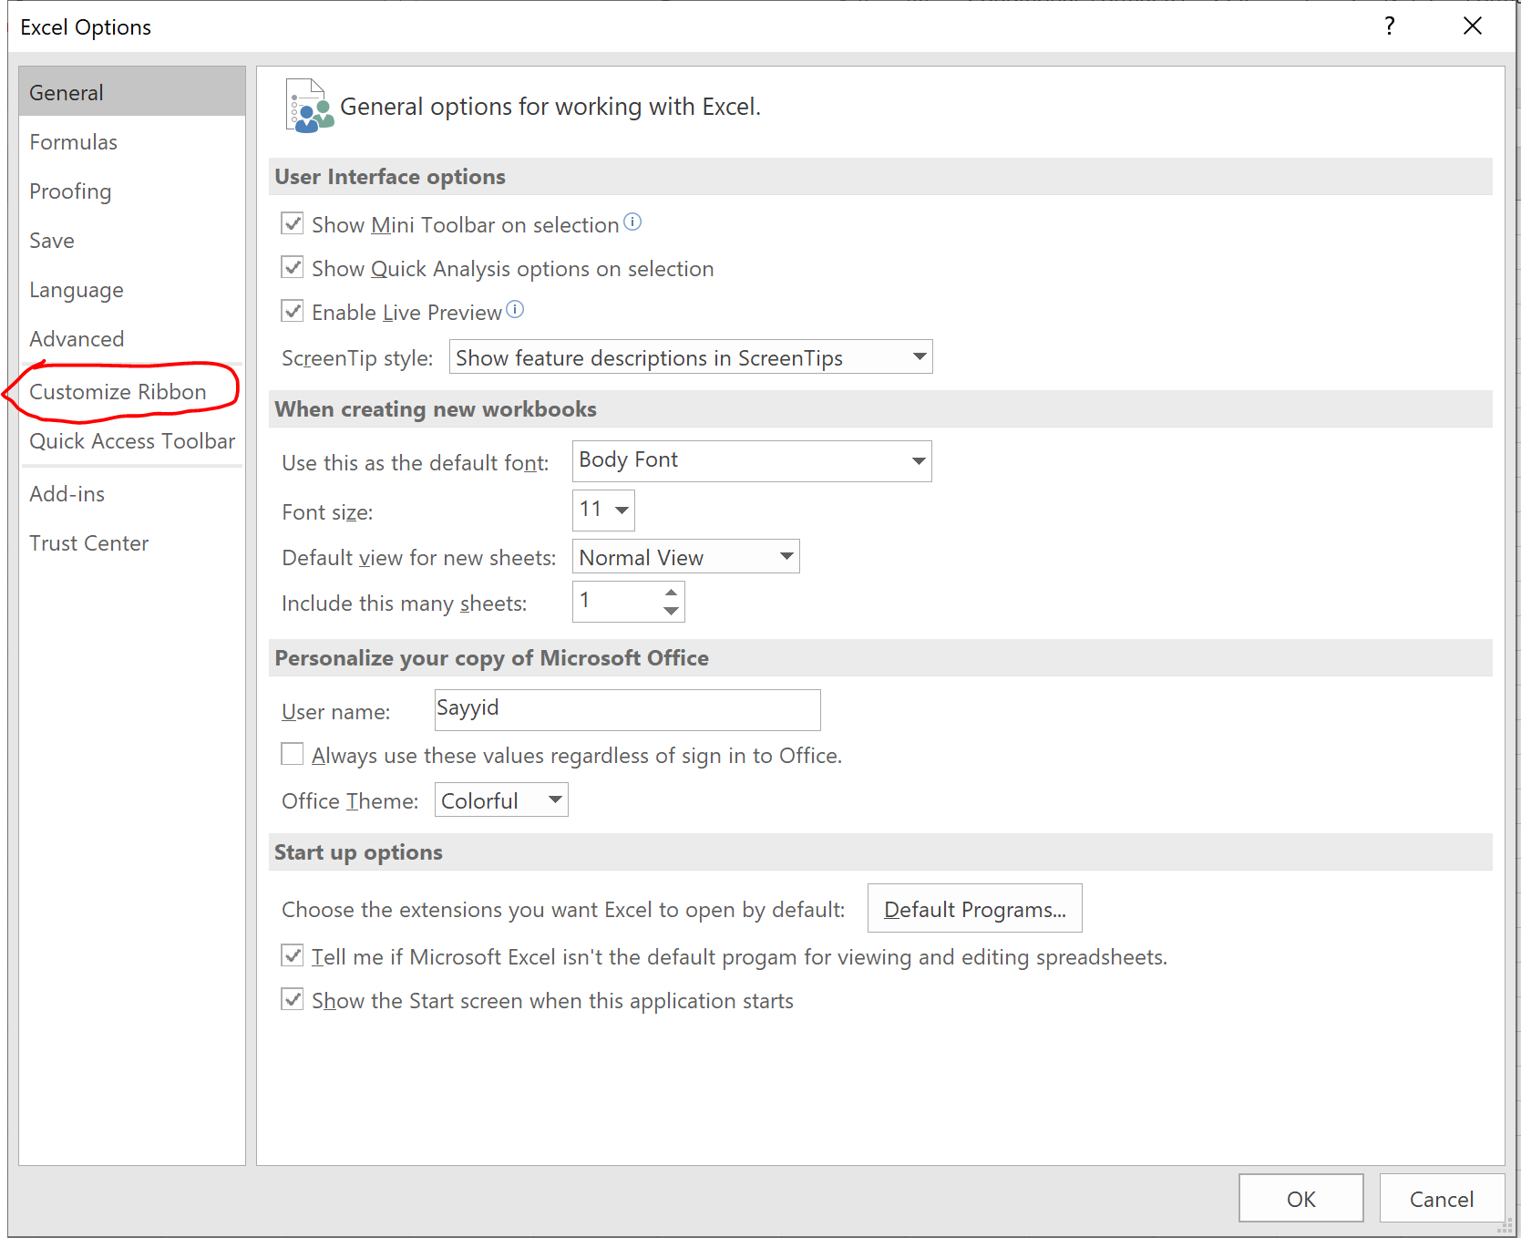
How to open VBA in Excel ? (Windows)
Click on the “customize ribbon” tab

Slide 12
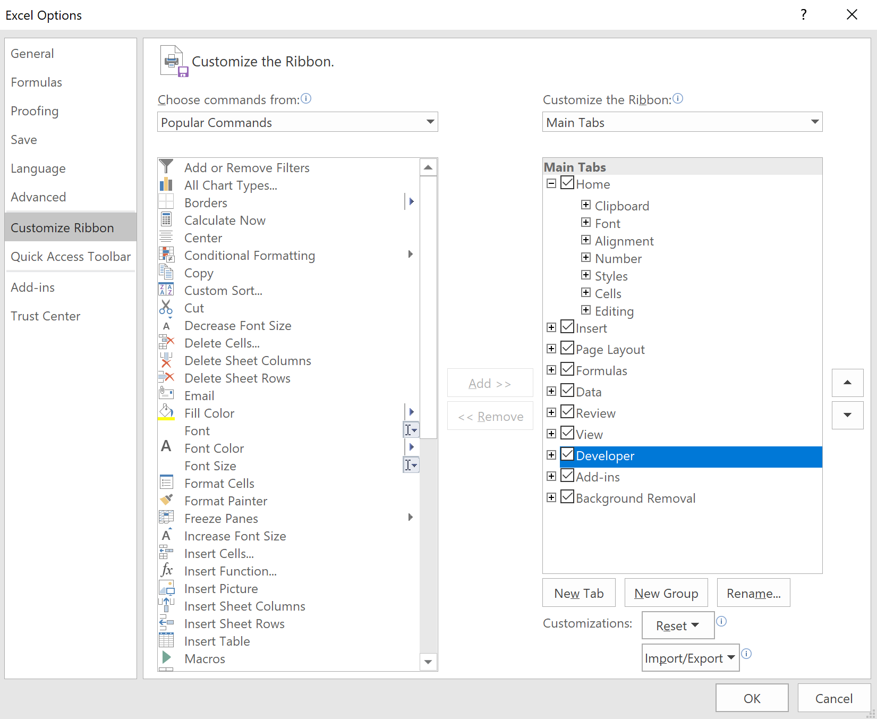
How to open VBA in Excel ? (Windows)
Ensure that the developer checkbox is ticked

Slide 13
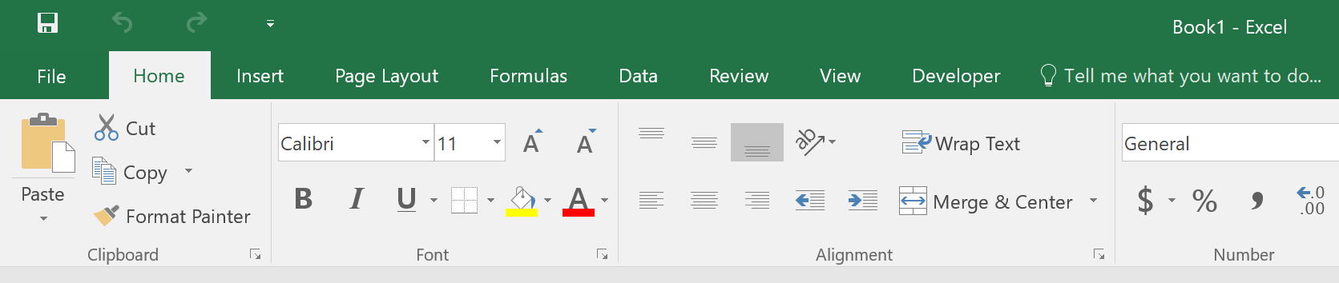
How to open VBA in Excel ? (Windows)
When u close the popup menu, and come back to the mainpage, developer tab
should be available

Slide 14
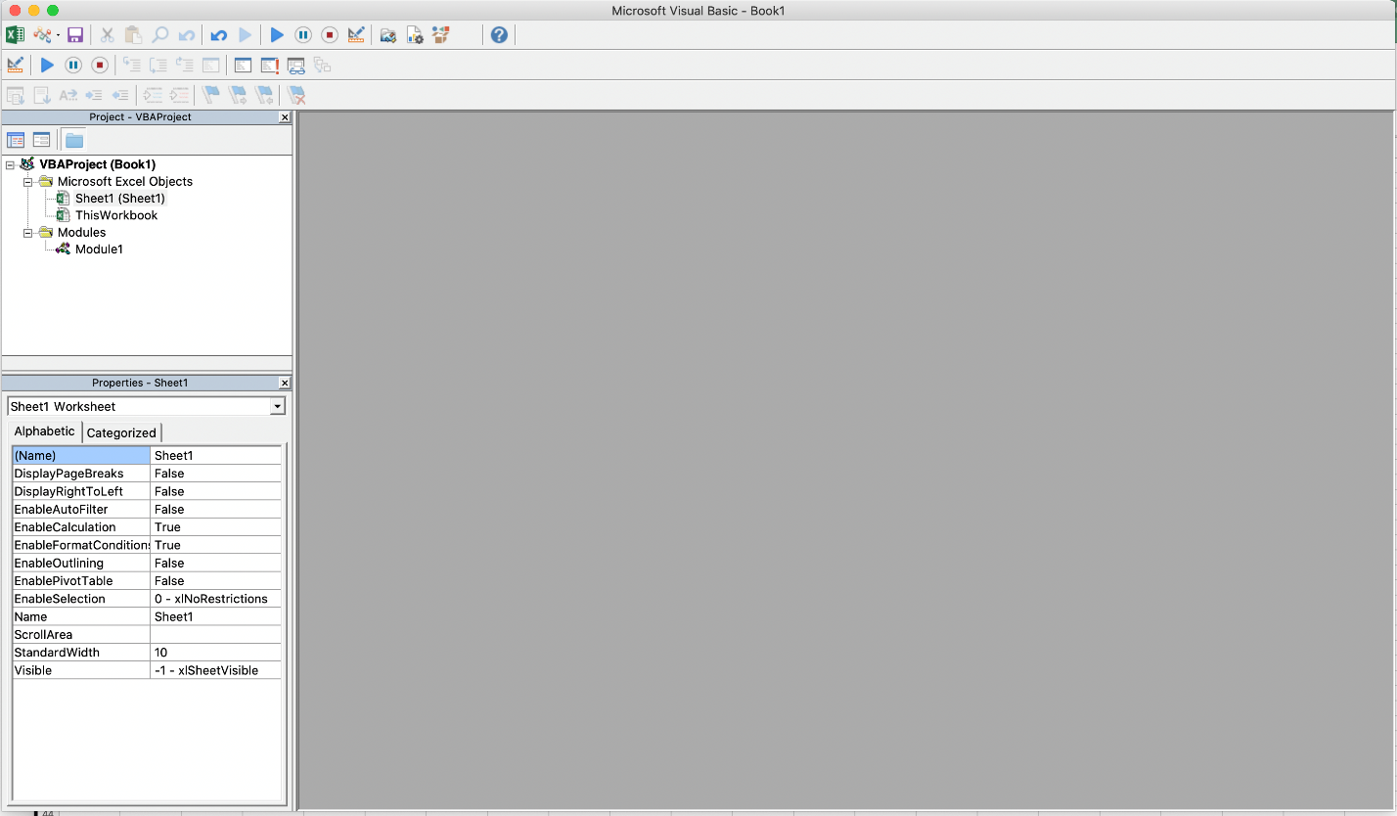
Starting Excel VBA
You should be welcomed with this screen

Slide 15
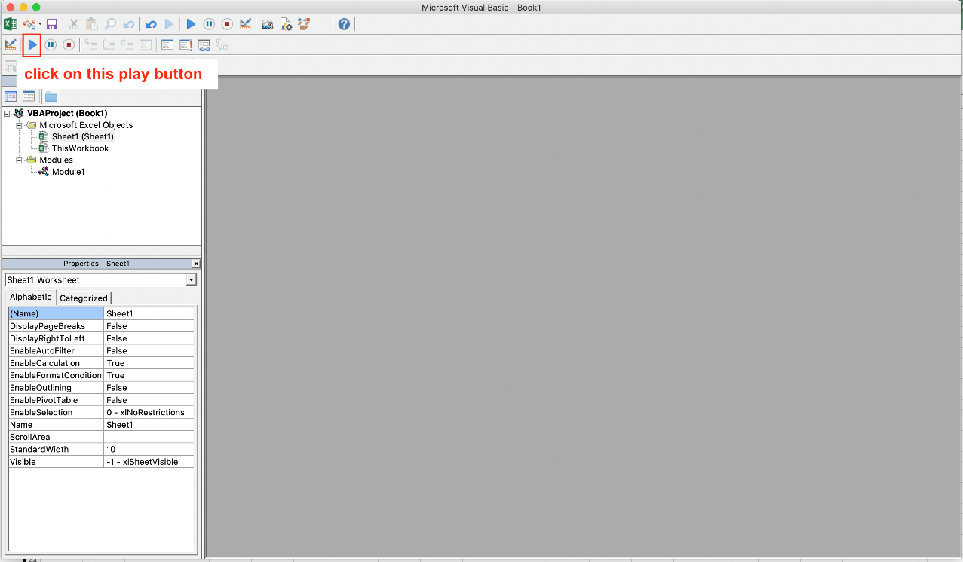
Starting Excel VBA
Click on the play button – to create a script

Slide 16
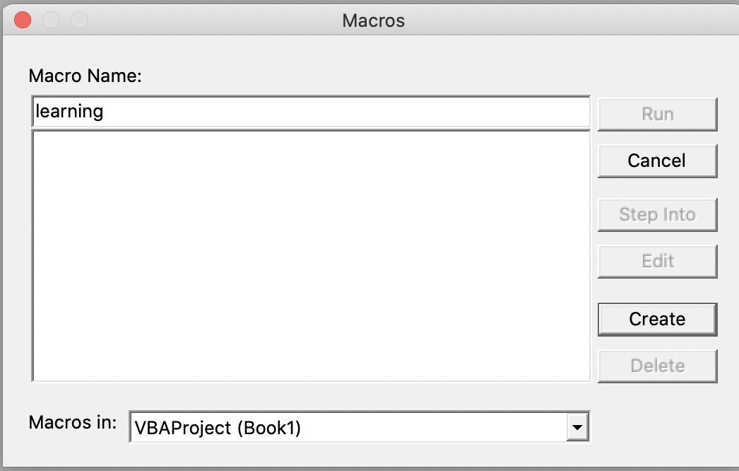
Starting Excel VBA
Create a macro name called “learning” and press create button

Slide 17
RoadMAP
Lesson Outline
Starting Excel VBA
Writing your first Macro
Visual Basic Datatypes

Slide 18
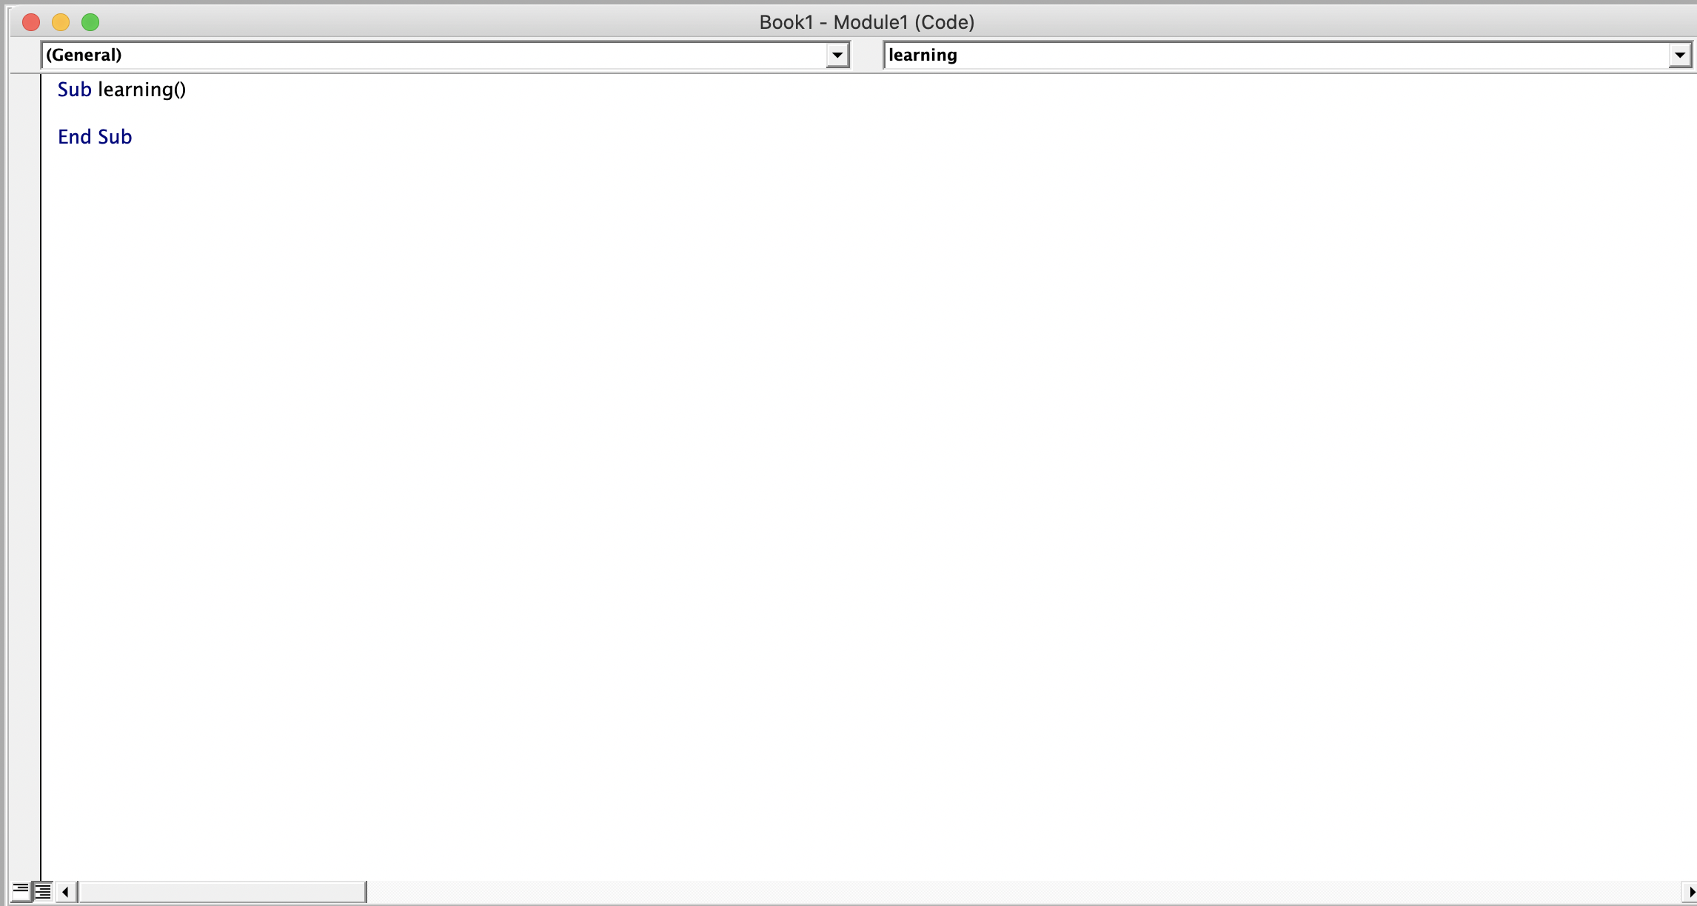
Writing Your First Macro
You should be welcome to this blank worksheet to work on

Slide 19
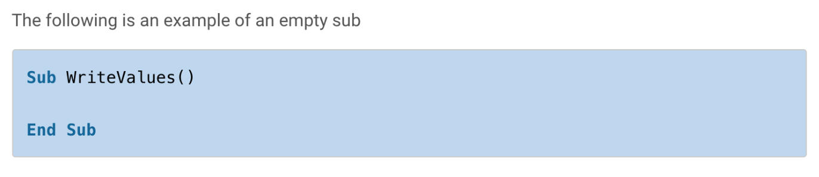
Writing Your First Macro (Learning Basics)
What is a Sub?
In Excel VBA a sub and a macro are essentially the same thing. This often leads to confusion so it is a good idea to remember it. For the rest of this post I will refer to them as subs.
A sub/macro is where you place your lines of VBA code. When you run a sub, all the lines of code it contains are executed. That means that VBA carries out their instructions.
The end of the Sub is marked by the line End Sub.

Slide 20
Writing Your First Macro (Learning Basics)
Things to take note of for Sub Keyword
You declare the sub by using the Sub keyword and the name you wish to give the sub. When you give it a name keep the following in mind:
The name must begin with a letter and cannot contain spaces.
The name must be unique in the current workbook.
The name cannot be a reserved word in VBA.

Slide 21
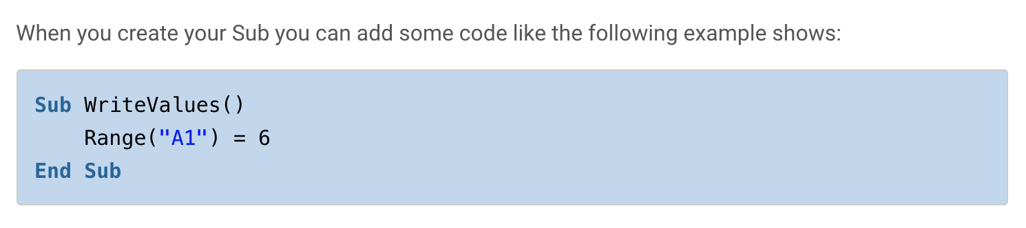
Writing Your First Macro (Learning Basics)
Sample Code for Sub

Slide 22
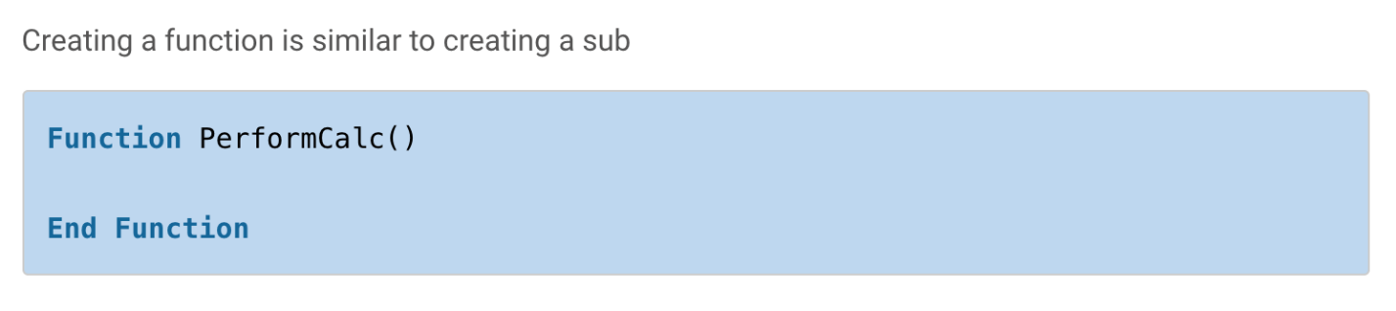
Writing Your First Macro (Learning Basics)
What is a Function?
A Function is very similar to a sub. The major difference is that a function can return a value – a sub cannot. There are other differences which we will look at but this is the main one.
You normally create a function when you want to return a value.

Slide 23
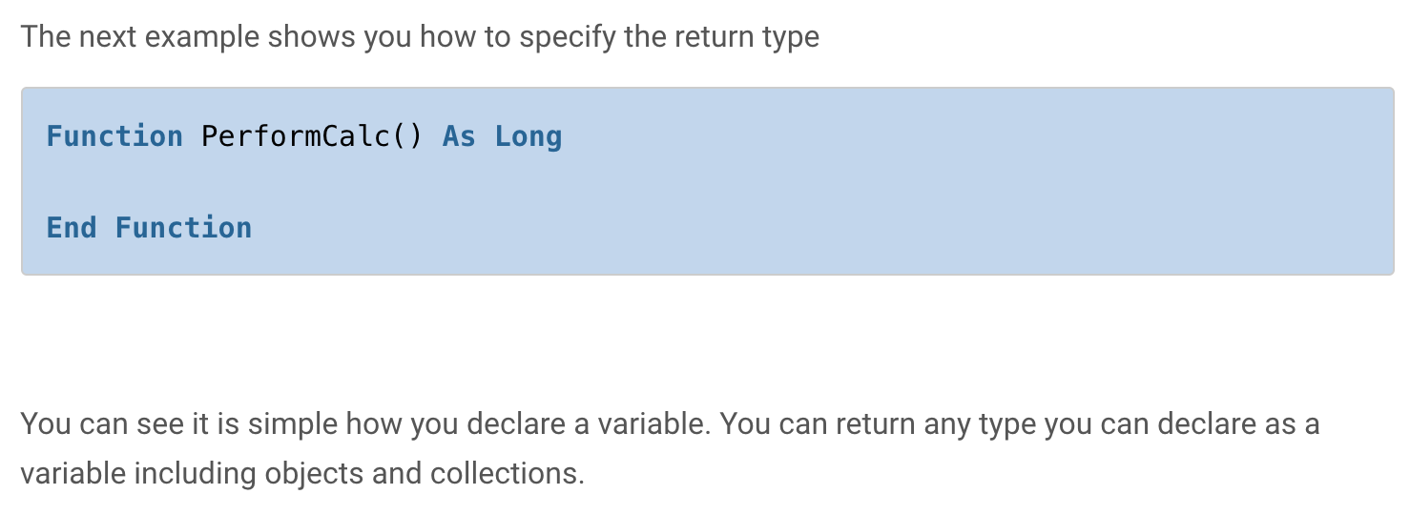
Writing Your First Macro (Learning Basics)
Things to take note of for Function Keyword
It is optional to add a return type to a function. If you don’t add the type then it is a Variant type by default. This means that VBA will decide the type at runtime.

Slide 24
Writing Your First Macro (Learning Basics)
A QUICK COMPARSION
Sub:
Cannot return a value.
Can be called from VBA\Button\Event etc.
Function
Can return a value but doesn’t have to.
Can be called it from VBA\Button\Event etc. but it won’t appear in the list of Macros. You must type it in.
If the function is public, will appear in the worksheet function list for the current workbook.

Slide 25
Writing Your First Macro (Learning Basics)
CALLING A SUB OR FUNCTION
When people are new to VBA they tend to put all the code in one sub. This is not a good way to write your code.
It is better to break your code into multiple procedures. We can run one procedure from another.

Slide 26
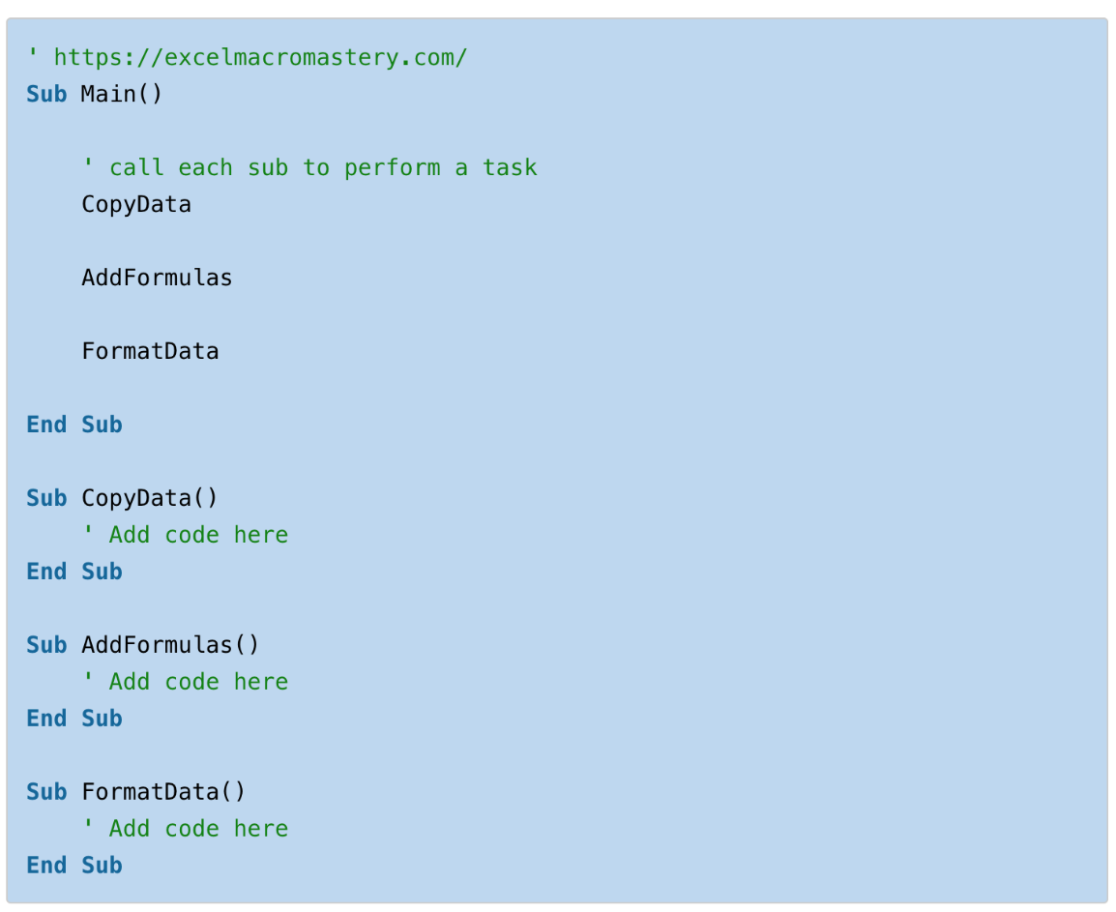
Writing Your First Macro (Learning Basics)
AN EXAMPLE:

Slide 27
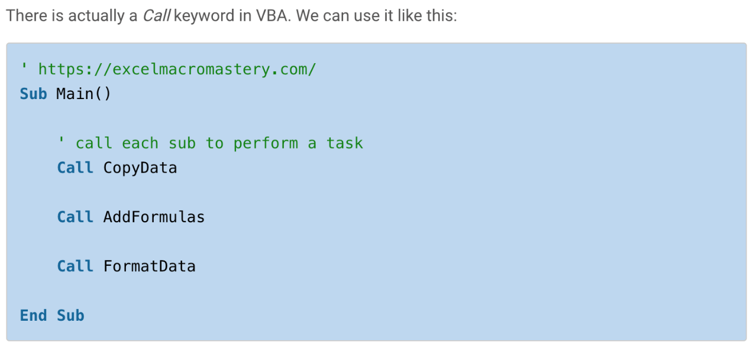
Writing Your First Macro (Learning Basics)
You can see that in the Main sub, we have added the name of three subs. When VBA reaches a line containing a procedure name, it will run the code in this procedure.
We refer to this as calling a procedure e.g. We are calling the CopyData sub from the Main sub.

Slide 28
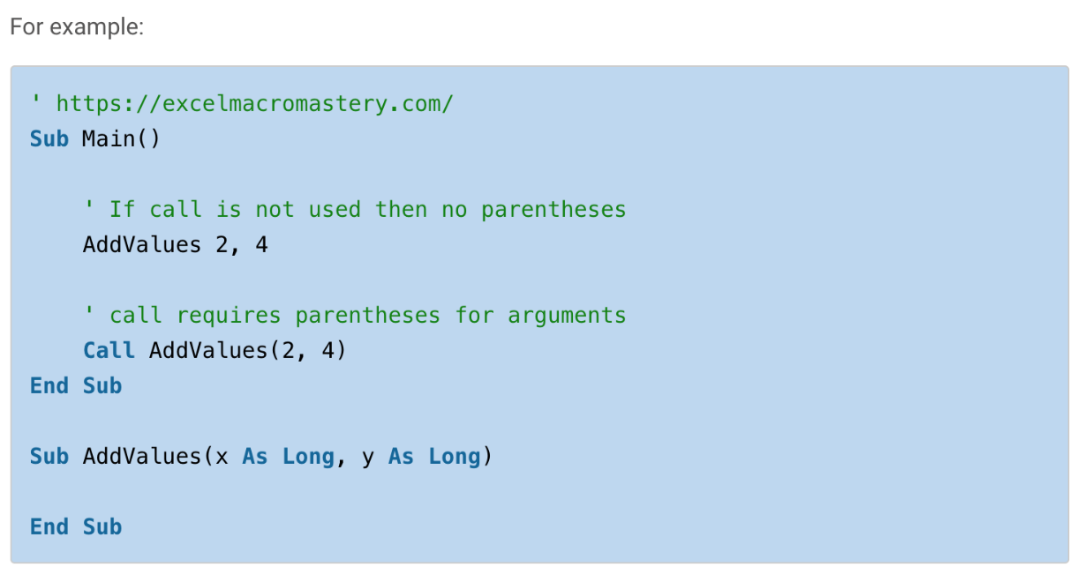
Writing Your First Macro (Learning Basics)
USING THE CALL KEYWORD IS OPTIONAL
There is no real need to use it unless you are new to VBA and you feel it makes your code more readable.
If you are passing arguments using Call then you must use parentheses around them.

Slide 29
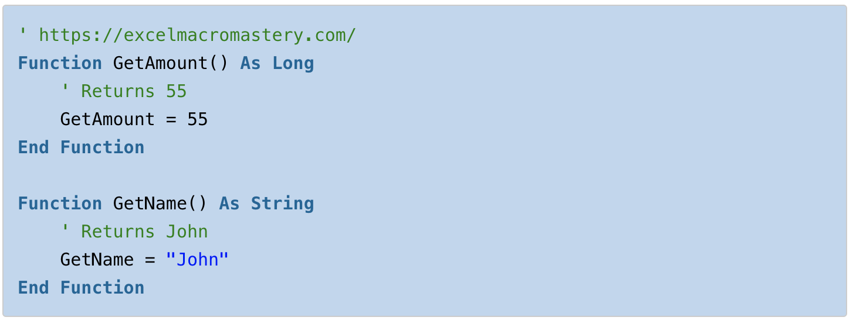
Writing Your First Macro (Learning Basics)
HOW TO RETURN VALUES FROM A FUNCTION
To return a value from a function you assign the value to the name of the Function. The following example demonstrates this:

Slide 30
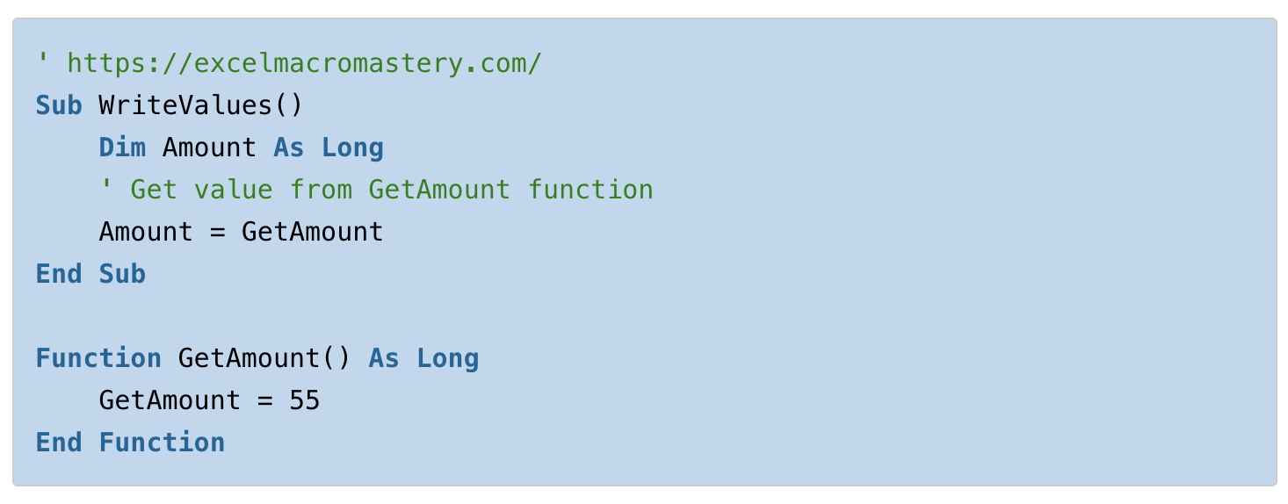
Writing Your First Macro (Learning Basics)
HOW TO RECEIVE VALUE FROM A FUNCTION
When you return a value from a function you will obviously need to receive it in the function/sub that called it. You do this by assigning the function call to a variable. The following example shows this:

Slide 31
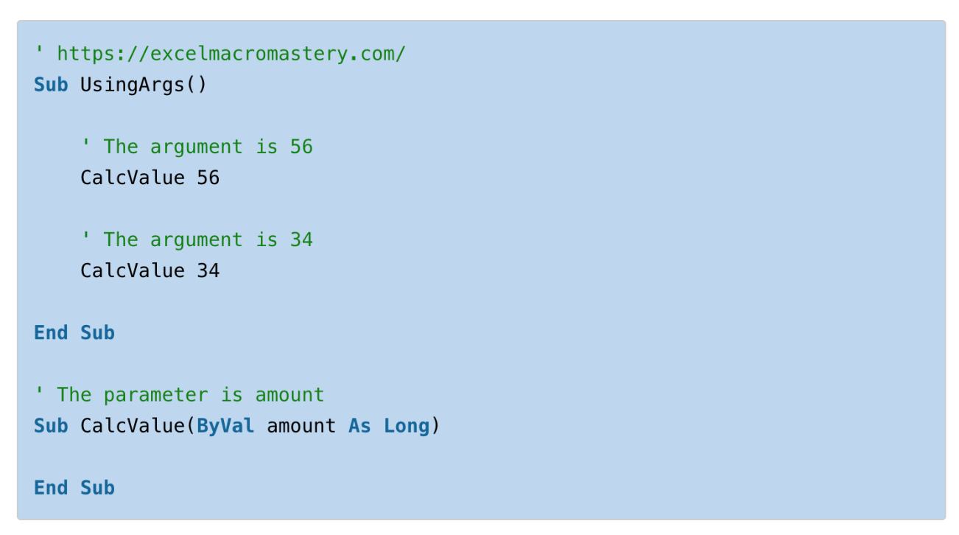
Writing Your First Macro (Learning Basics)
USING PARAMETERS AND ARGUMENTS
We use parameters so that we can pass values from one sub/function to another.
The terms parameters and arguments are often confused:
A parameter is the variable in the sub/function declaration.
An argument is the value that you pass to the parameter.

Slide 32
Writing Your First Macro (Learning Basics)
Here are some important points about parameters:
We can have multiple parameters.
A parameter is passed using either ByRef or ByVal. The default is ByRef.
We can make a parameter optional for the user.
We cannot use the New keyword in a parameter declaration.
If no variable type is used then the parameter will be a variant by default.

Slide 33
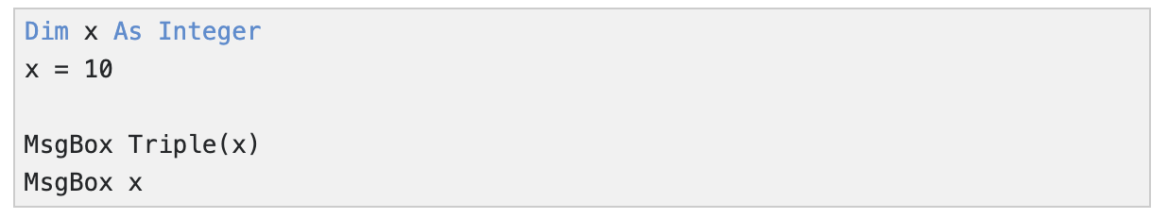
Writing Your First Macro (Learning Basics)
ByRef & ByVal COMPARISON
You can pass arguments to a procedure (function or sub) by reference or by value. By default, Excel VBA passes arguments by reference. As always, we will use an easy example to make things more clear.
Place a command button on your worksheet and add the following code lines:

Slide 34
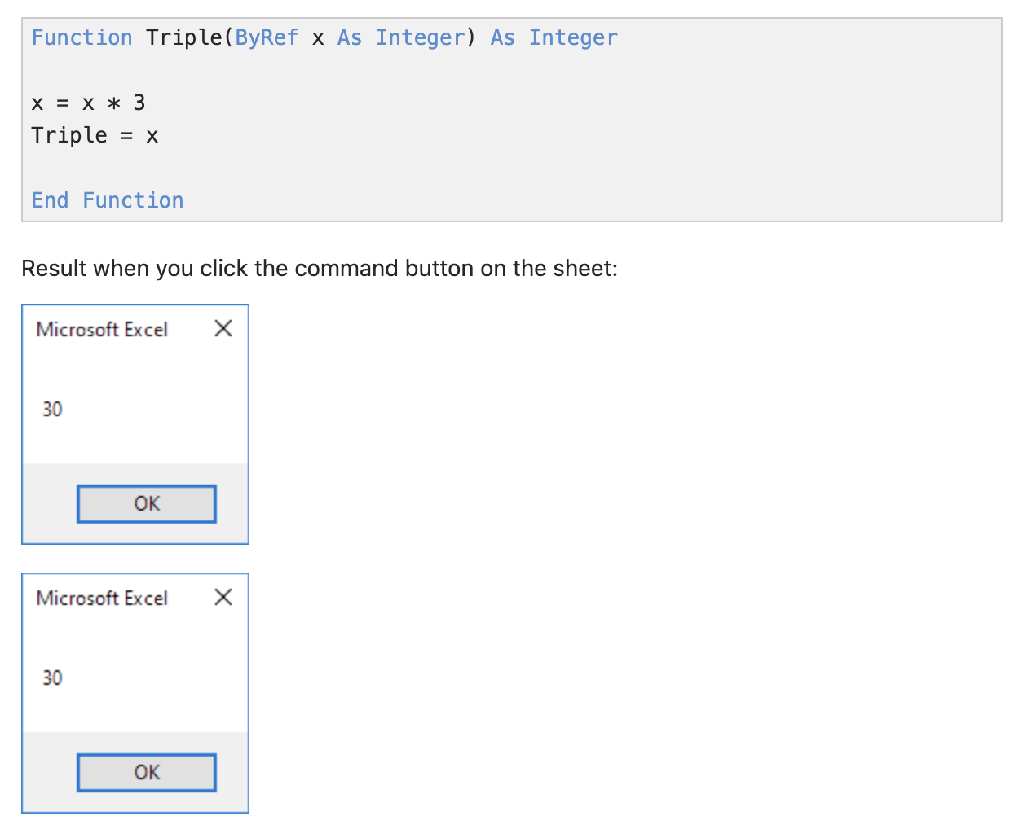
Writing Your First Macro (Learning Basics)
ByRef & ByVal COMPARISON
The code calls the function Triple. It's the result of the second MsgBox we are interested in. Functions need to be placed into a module.
1. Open the Visual Basic Editor and click Insert, Module.
2. Add the following code lines:

Slide 35
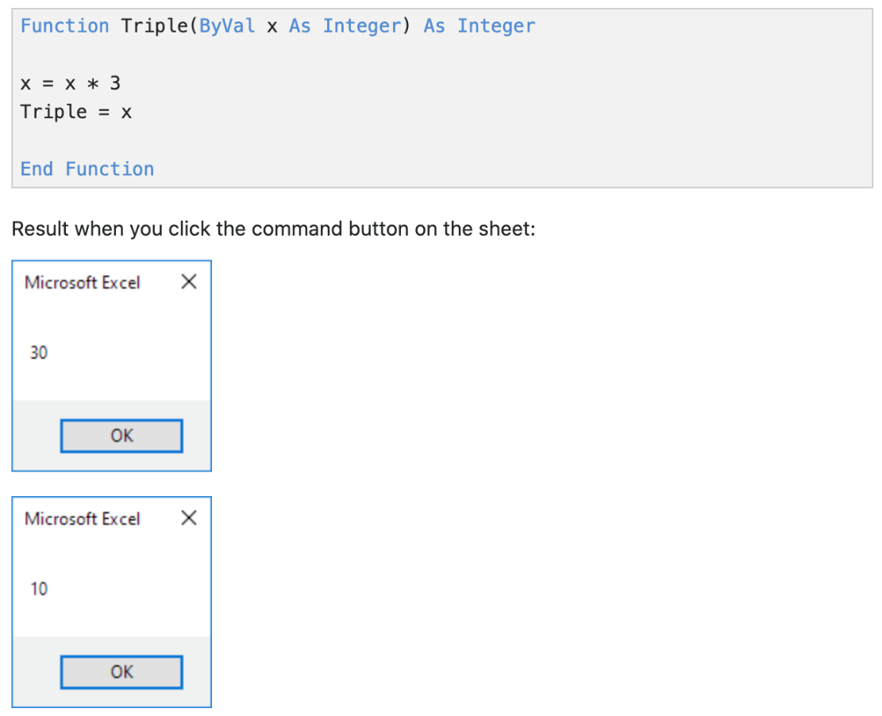
Writing Your First Macro (Learning Basics)
ByRef & ByVal COMPARISON
3. Replace ByRef with ByVal.
Explanation: When passing arguments by reference we are referencing the original value. The value of x (the original value) is changed in the function. As a result the second MsgBox displays a value of 30. When passing arguments by value we are passing a copy to the function. The original value is not changed. As a result the second MsgBox displays a value of 10 (the original value).
https://www.excel-easy.com/vba/examples/byref-byval.html

Slide 36
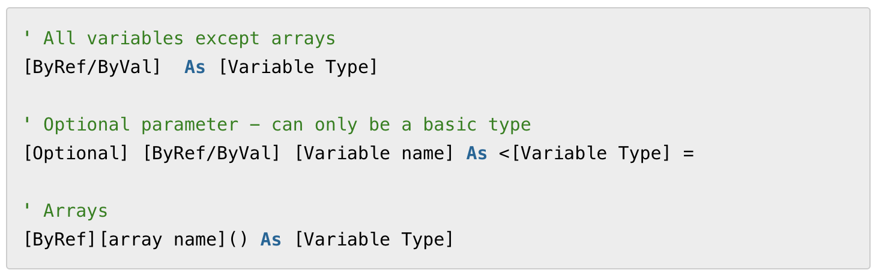
Writing Your First Macro (Learning Basics)
THE FORMAT OF PARAMETERS
Subs and function use parameters in the same way.
The format of the parameter statement is as follows:

Slide 37
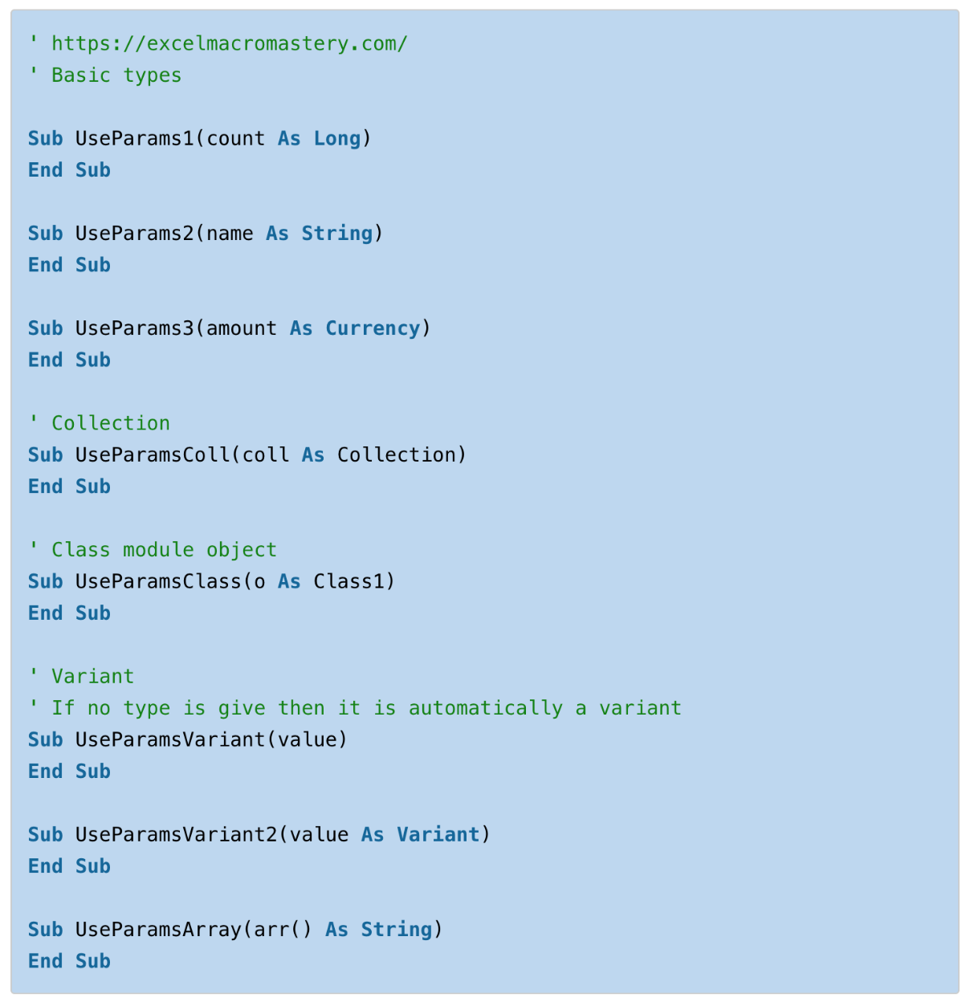
Here are some examples of the declaring different types of parameters:
You can see that declaring parameters looks similar to using the Dim statement to declare variables.

Slide 38
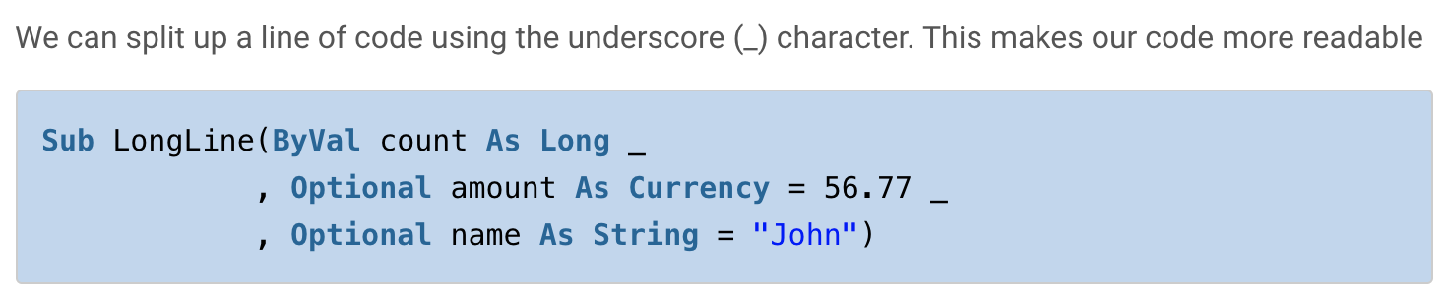
Writing Your First Macro (Learning Basics)
MULTIPLE PARAMETERS
We can use multiple parameters in our sub/functions. This can make the line very long
Sub LongLine(ByVal count As Long, Optional amount As Currency = 56.77, Optional name As String = "John")

Slide 39
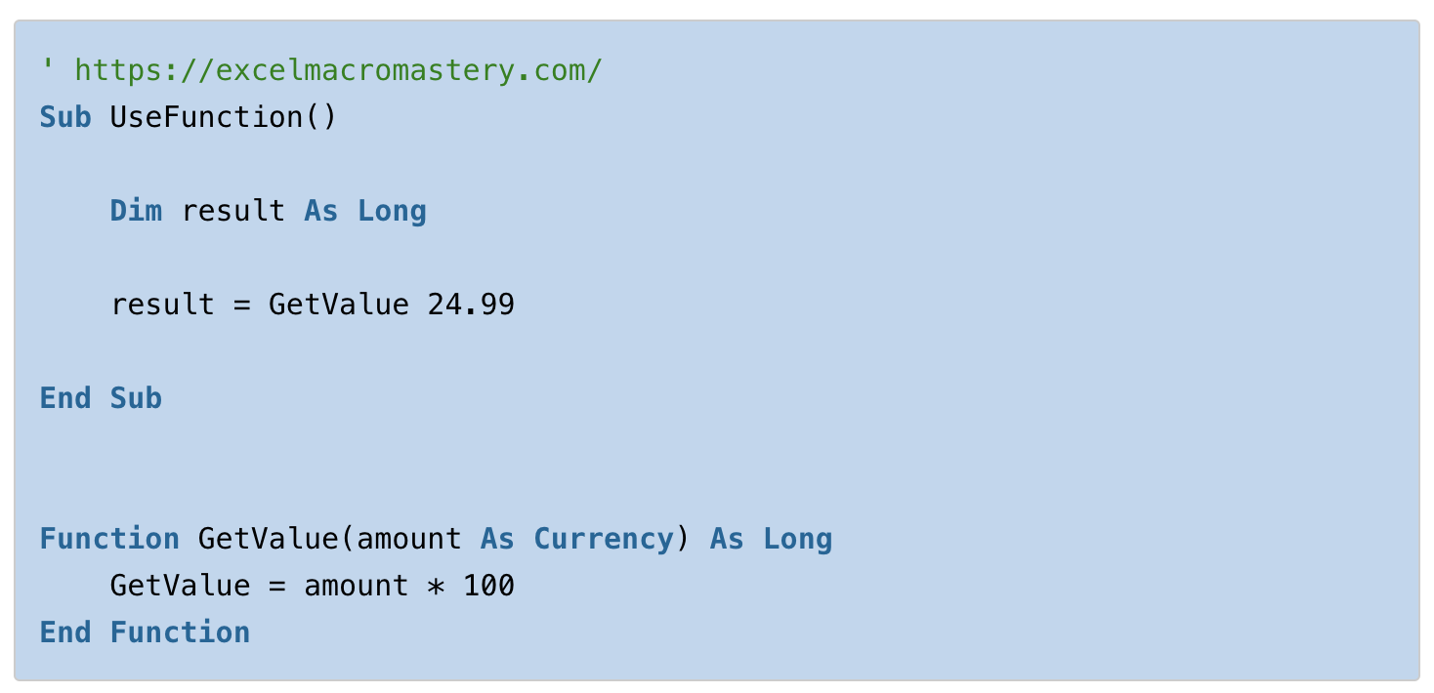
Writing Your First Macro (Learning Basics)
PARAMETERS WITH RETURN VALUE
This error causes a lot of frustration with new users of VBA.
If you are returning a value from a function then it must have parentheses around the arguments.
The code below will give the “Expected: end of statement” syntax error.

Slide 40
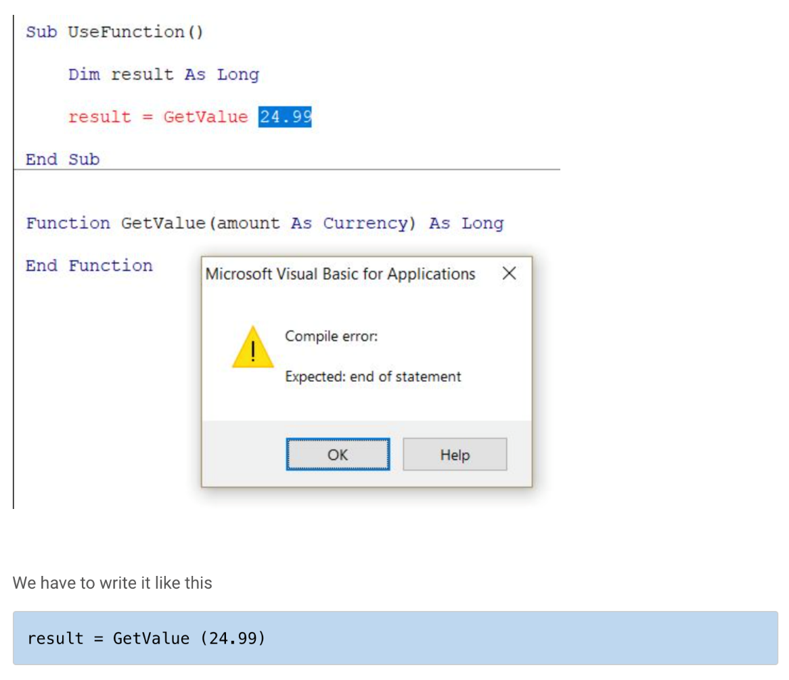
Writing Your First Macro (Learning Basics)
PARAMETERS WITH RETURN VALUE

Slide 41
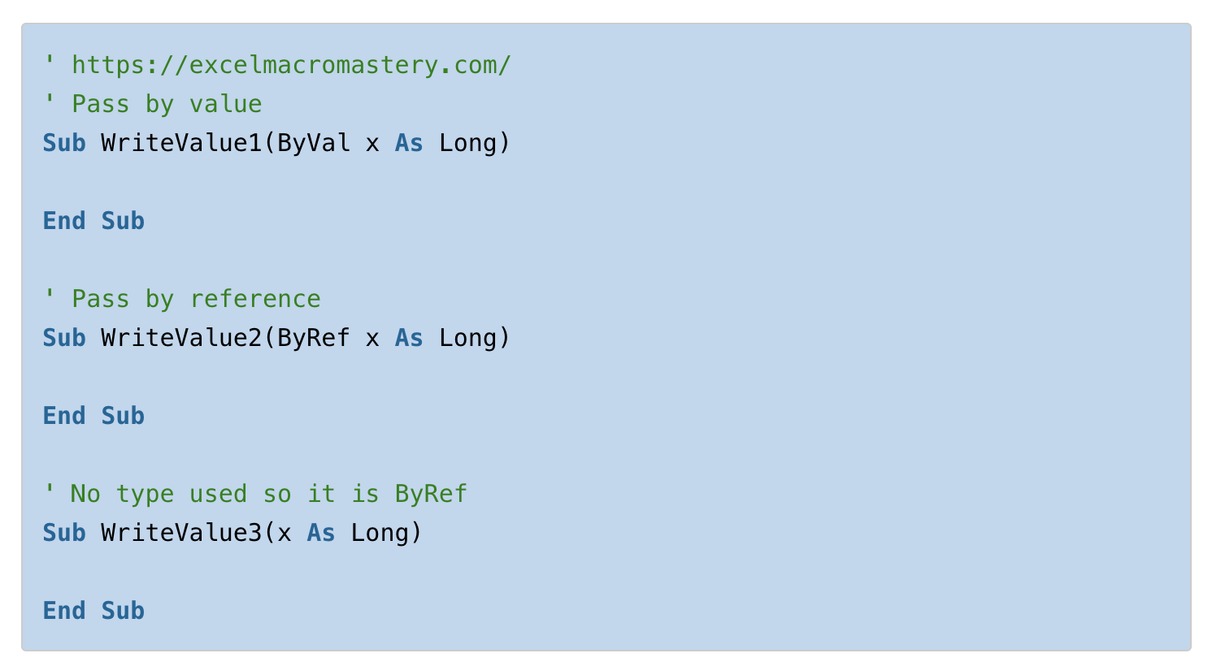
Writing Your First Macro (Learning Basics)
REVISION WITH BYREF & BYVAL

Slide 42
Writing Your First Macro (Learning Basics)
REVISION WITH BYREF & BYVAL
If you don’t specify the type then ByRef is the type as you can see in the third sub of the example.
The different between these types is:
ByVal – Creates a copy of the variable you pass. This means if you change the value of the parameter it will not be changed when you return to the calling sub/function
ByRef – Creates a reference of the variable you pass. This means if you change the value of the parameter variable it will be changed when you return to the calling sub/function.

Slide 43
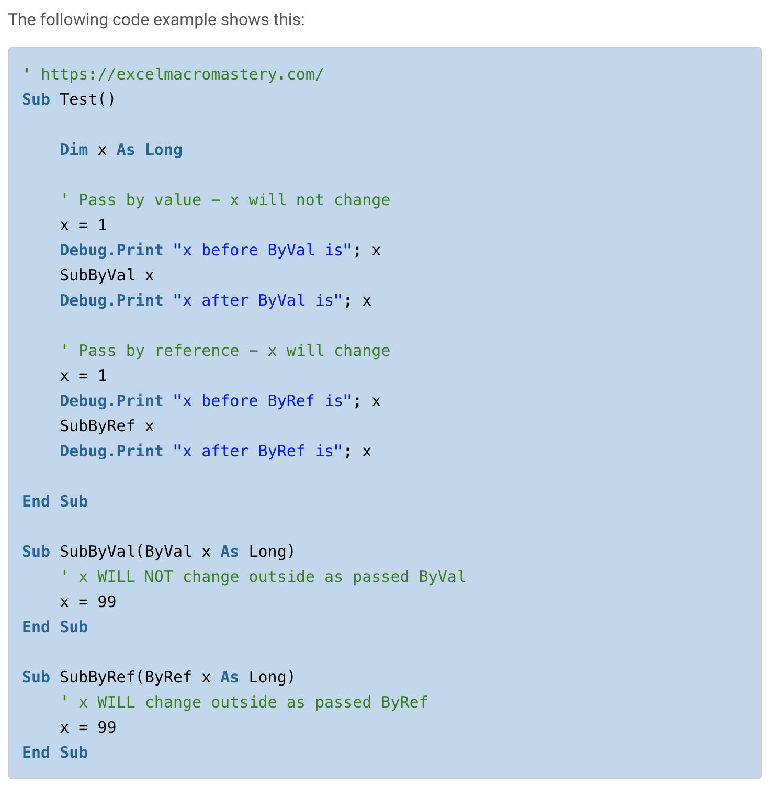
The result of this is: x before ByVal is 1 x after ByVal is 1 x before ByRef is 1 x after ByRef is 99

Slide 44
Writing Your First Macro (Learning Basics)
REVISION WITH BYREF & BYVAL
You should avoid passing basic variable types using ByRef. There are two main reasons for this:
The person passing a value may not expect it to change and this can lead to bugs that are difficult to detect.
Using parentheses when calling prevents ByRef working

Slide 45
Writing Your First Macro (Learning Basics)
A Little-Known Pitfall of ByRef
There is one thing you must be careful of when using ByRef with parameters. If you use parentheses then the sub/function cannot change the variable you pass even if it is passed as ByRef.
In the following example, we call the sub first without parentheses and then with parentheses. This causes the code to behave differently.

Slide 46
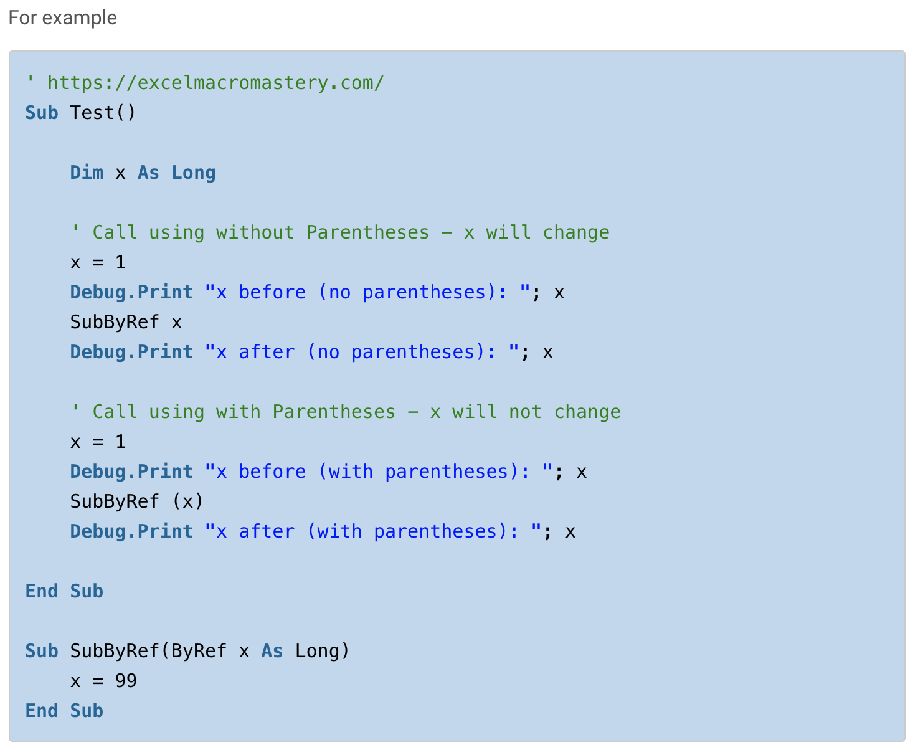

Slide 47
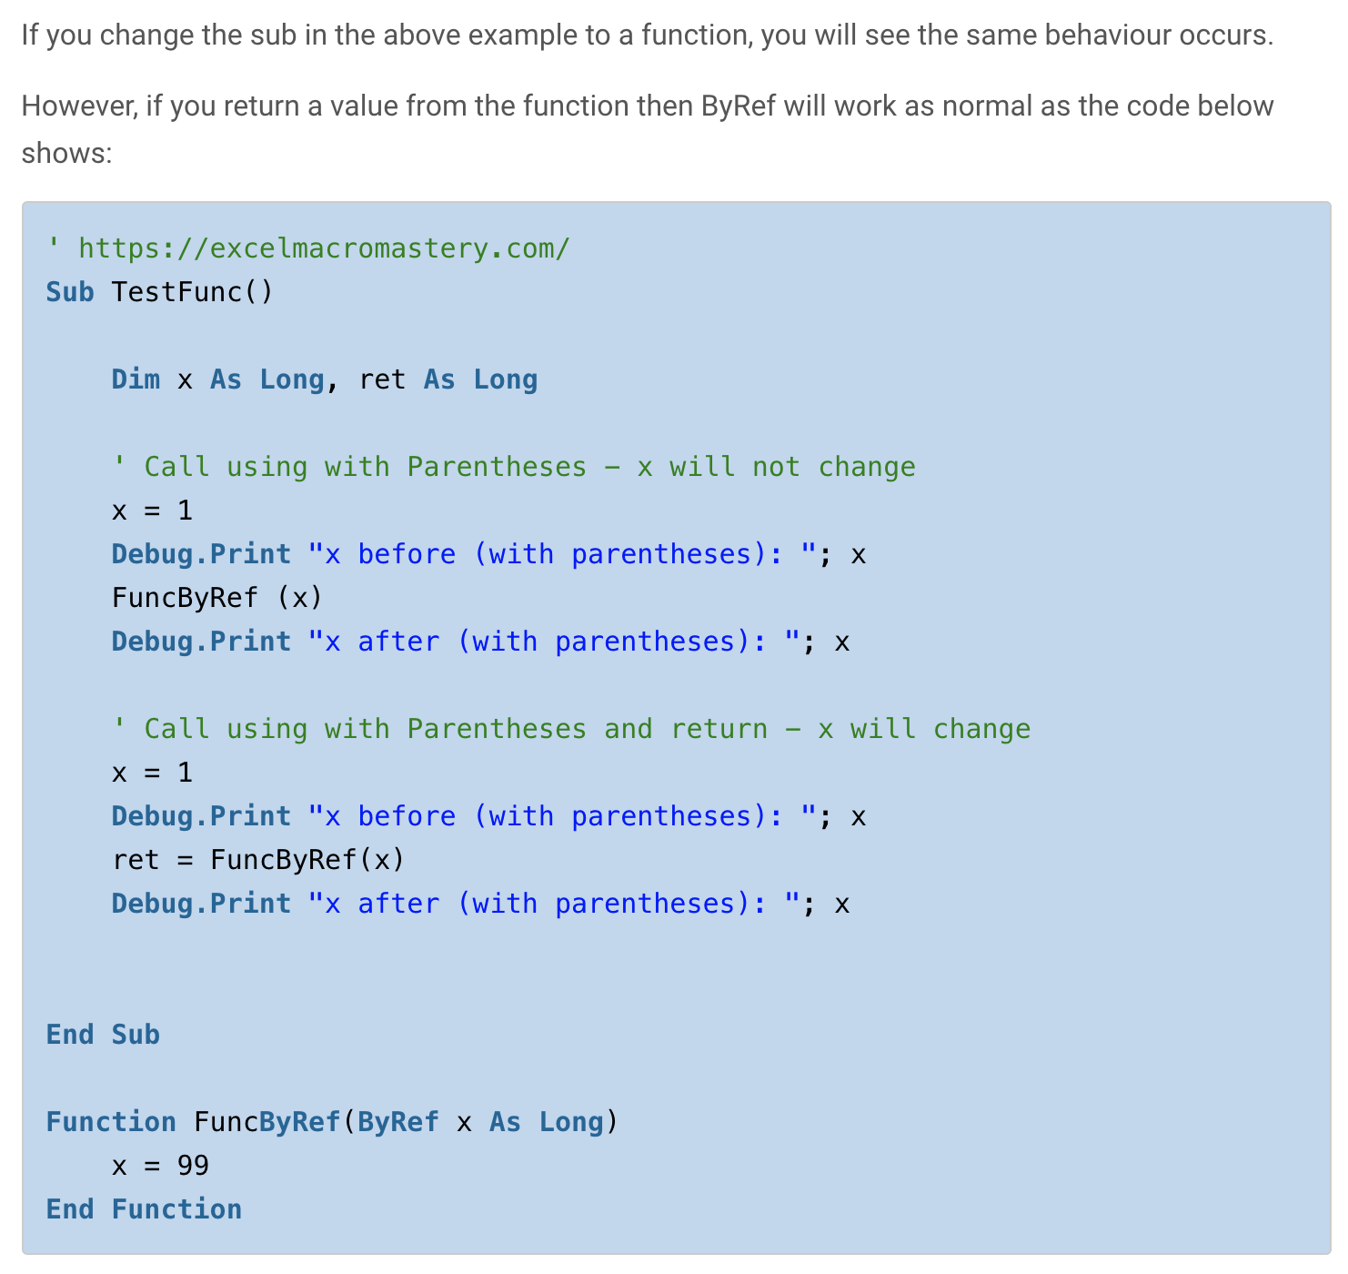

Slide 48
Writing Your First Macro (Learning Basics)
A Little-Known Pitfall of ByRef
As I said in the last section you should avoid passing a variable using ByRef and instead use ByVal.
This means
1. The variable you pass will not be accidentally changed.
2. Using parentheses will not affect the behaviour.
https://excelmacromastery.com/excel-vba-sub/#:~:text=A%20sub%2Fmacro%20is%20where,VBA%20carries%20out%20their%20instructions.&text=You%20declare%20the%20sub%20by,wish%20to%20give%20the%20sub.

Slide 49
Writing Your First Macro (Learning Basics)
A Little-Known Pitfall of ByRef
As I said in the last section you should avoid passing a variable using ByRef and instead use ByVal.
This means
1. The variable you pass will not be accidentally changed.
2. Using parentheses will not affect the behaviour.
https://excelmacromastery.com/excel-vba-sub/#:~:text=A%20sub%2Fmacro%20is%20where,VBA%20carries%20out%20their%20instructions.&text=You%20declare%20the%20sub%20by,wish%20to%20give%20the%20sub.

Slide 50
RoadMAP
Lesson Outline
Starting Excel VBA
Writing your first Macro
Visual Basic Datatypes

Slide 51
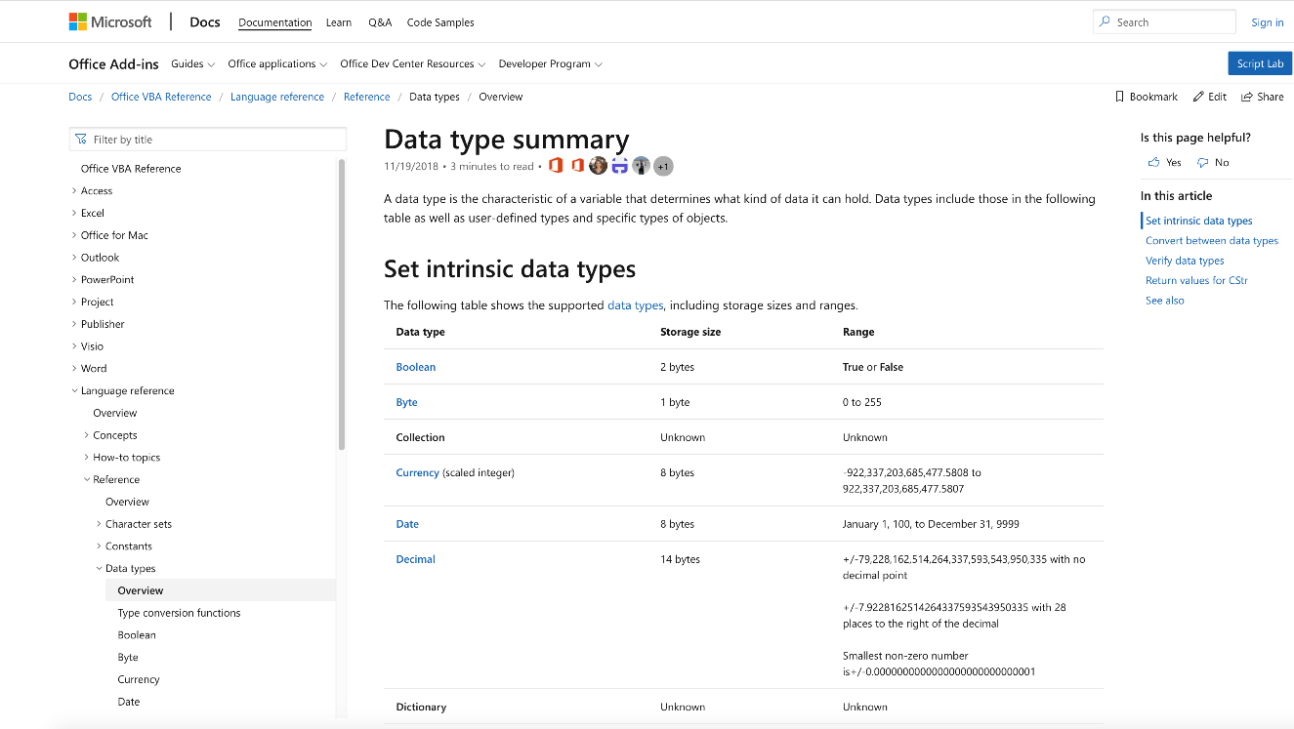
Data Types
https://docs.microsoft.com/en-us/office/vba/language/reference/user-interface-help/data-type-summary
Notes:
We will use the Microsoft website to learn and go through all the data types which are available on the Visual Basic

Slide 52
Happy Programming!

